Slide 1
Manual data analysis combined with automated data reduction at ISIS
Anders Markvardsen (presenter) of slides from
Franz Lang (intelligent customer of IDAaaS)
Dimitar Tasev (Autoreduction team lead)
1st July 2021, ESS DMSC

Slide 2

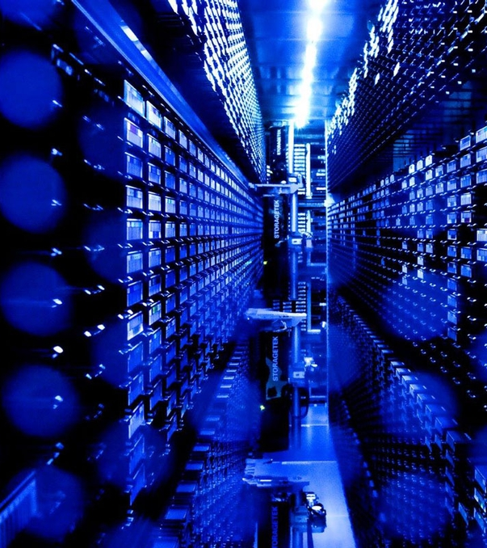
Agenda
Intro
Manual Data Analysis/Reduction
Automatic Data Reduction
Future Demands & Developments
Image © STFC Alan Ford

Slide 3
Agenda
Intro
Manual Data Analysis/Reduction
Automatic Data Reduction
Future Demands & Developments
Image © STFC Alan Ford

Slide 4
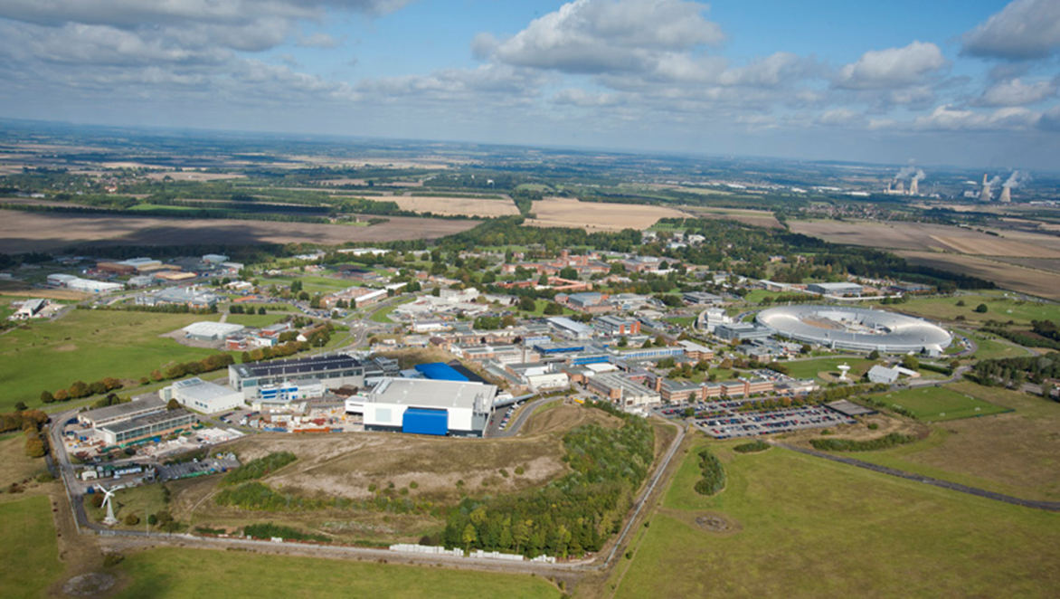

Slide 5
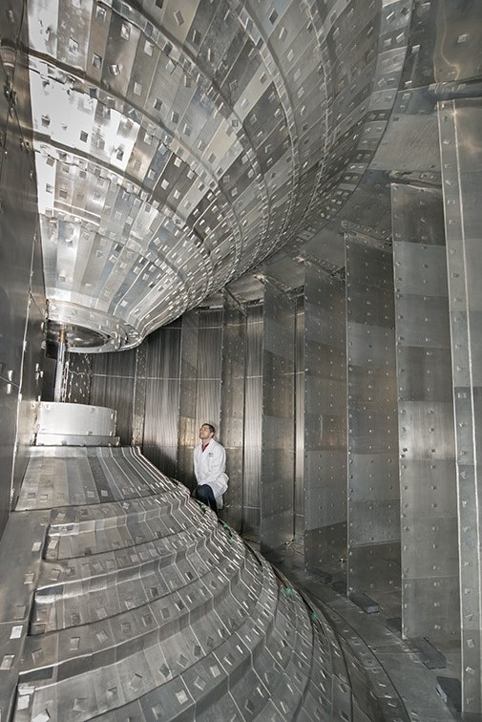
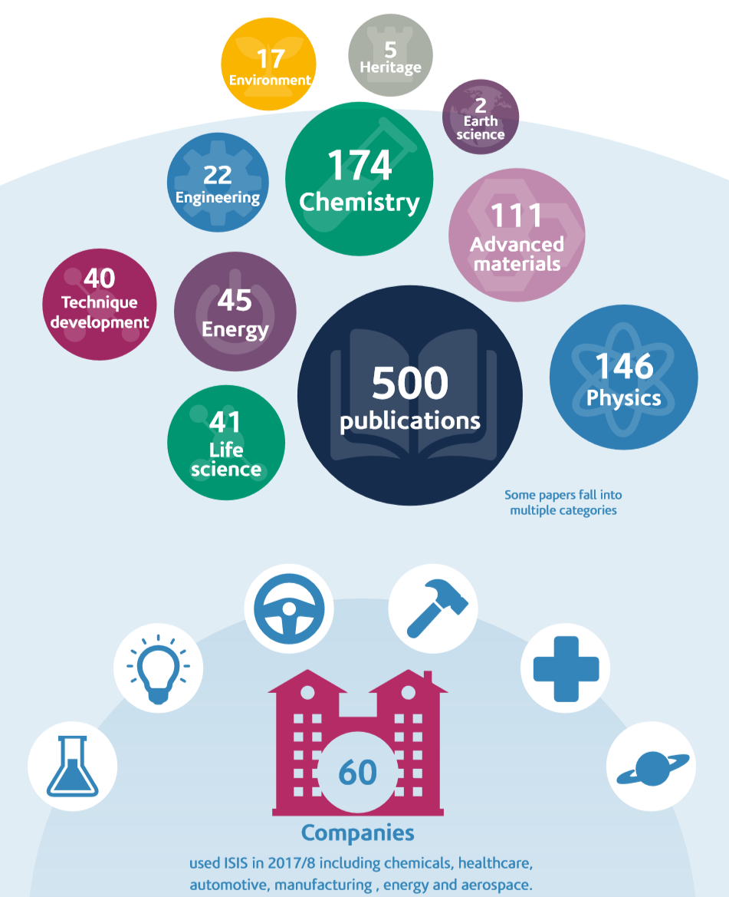
https://www.isis.stfc.ac.uk/Pages/Let.aspx https://www.isis.stfc.ac.uk/Pages/ISIS_Annual_review_2018.pdf

Slide 6
Raw
data
Data
reduction
Data
analysis

Slide 7
Agenda
Intro
Manual Data Analysis/Reduction
Automatic Data Reduction
Future Demands & Developments
Image © STFC Alan Ford

Slide 8
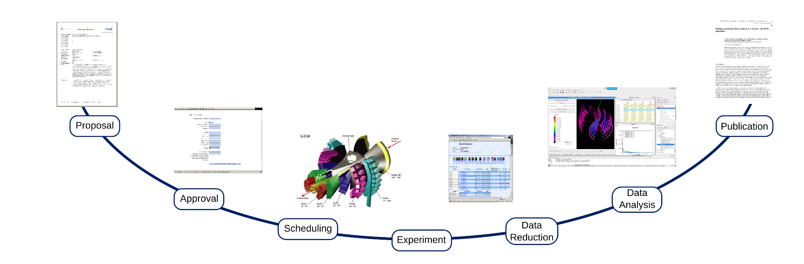
IDAaaS (ISIS Data Analysis as a Service) Platform

Slide 9
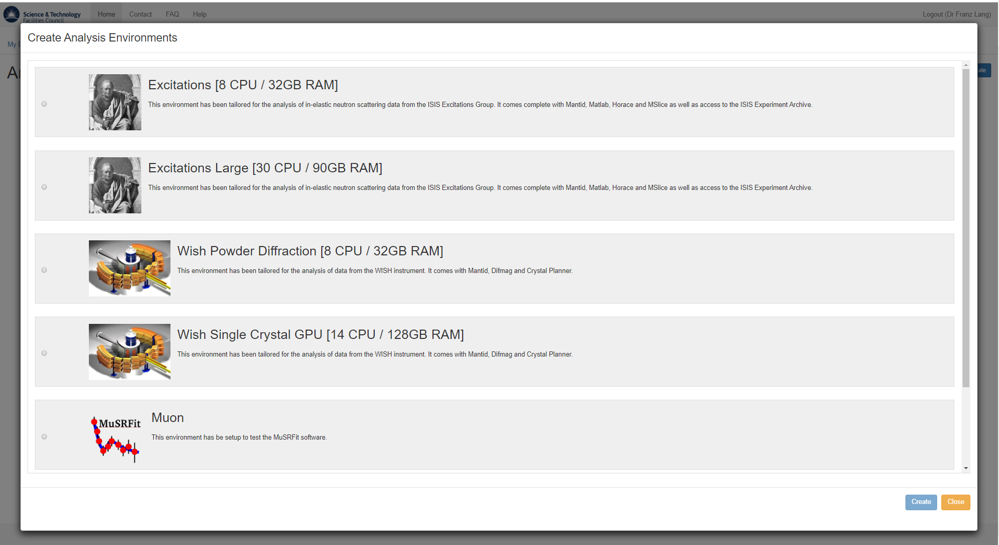
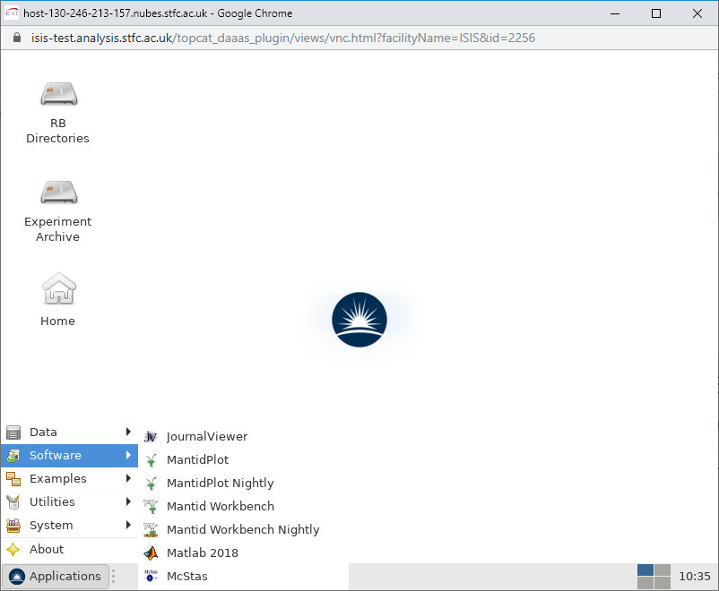

Slide 10
Aims & Customers
All ISIS users
ISIS scientific staff
Other ISIS staff, e.g. Detector Group, Software developers
Make available on EOSC (future)

Slide 11
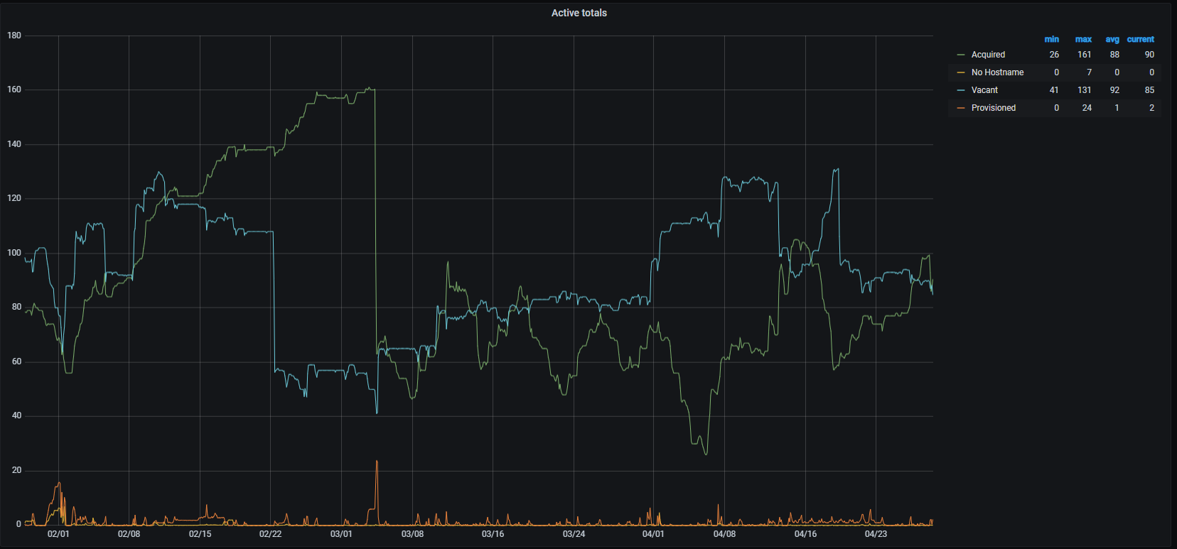
Status
ISIS
all instruments supported
~100 concurrent VMs
STFC cloud
258 max VMs
~20TB RAM
~4500 CPUs
~60 GPUs
5 permanent SCD staff
~3 SCD students
1 ISIS staff (Franz)
customer support
ticketing system
regular user meetings
Notes:
4 stages: provisioned, vacant, acquired and final no hostname, with the latter is an error state

Slide 12
Technical Aspects
VMs
STFC cloud resources
configuration via Ansible
VMM in Python
interface/connection
web front end in JS
through browser window
customised noVNC
ssh
authentication via ISIS UO
monitoring
Grafana
data
CEPH for user data
Archive for experiment data
shared “RB folders”
permissions: LDAP and acl rules
download via data browser front end
sprints/ticketing
Jira
support
Jira Service Desk
documentation
Confluence

Slide 13
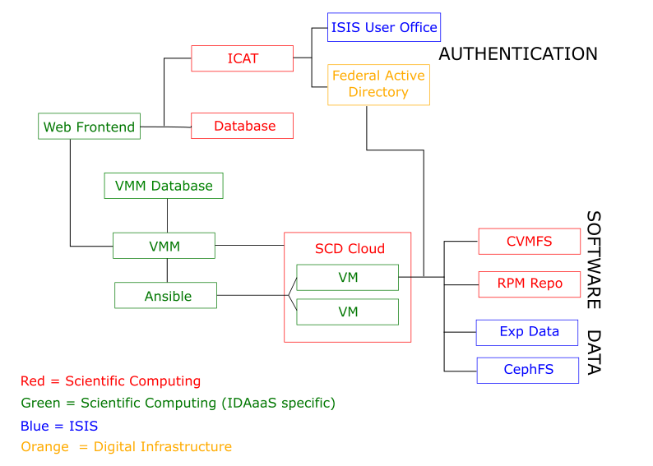

Slide 14
Contacts include:
ISIS
franz.lang@stfc.ac.uk
lamar.moore.stfc.ac.uk
anders.markvardsen@stfc.ac.uk
SCD
Gordon.brown@stfc.ac.uk

Slide 15
Agenda
Intro
Manual Data Analysis/Reduction
Automatic Data Reduction
Future Demands & Developments
Image © STFC Alan Ford

Slide 16
Autoreduciton (Automatic data reduction) Service

Slide 17
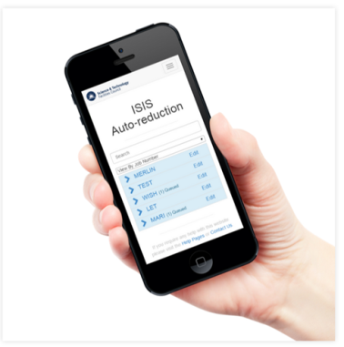


ISIS Data Cache Monitor
messages
messages
messages
Web interface
Compute
resources
Messaging Server

Slide 18
Aims & Customers
All ISIS users
ISIS scientific staff
ISIS Data Catalogue (future)

Slide 19
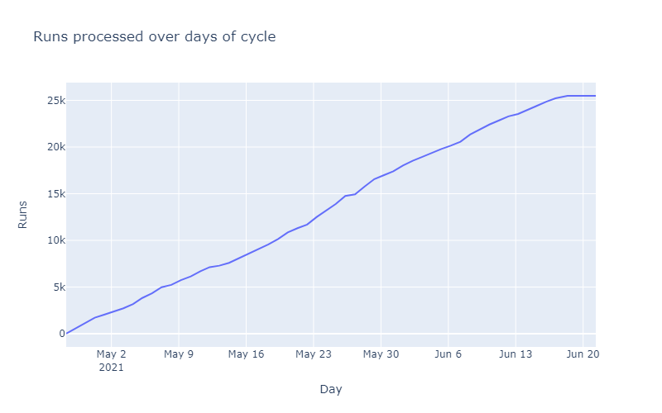
Status
ISIS
12 instruments and active on 22
Hardware
STFC cloud (10 VMs)
2 dedicated nodes
3 permanent staff by Sep
customer support
ticketing system (Jira)
On-call
~Quarterly user meetings

Slide 20
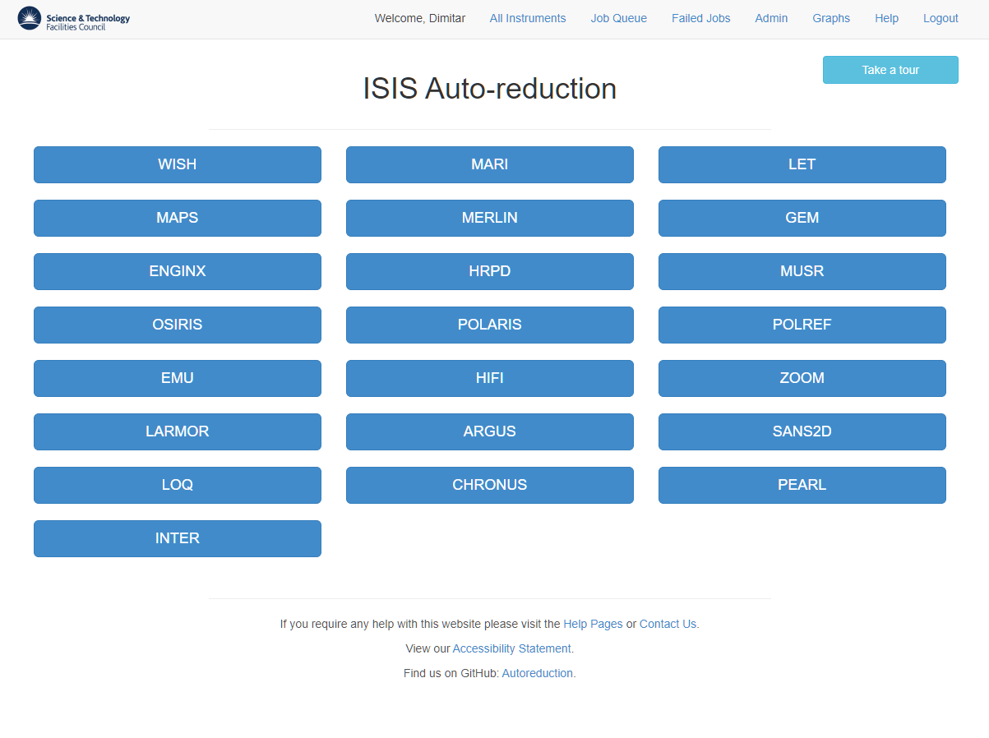

Slide 21
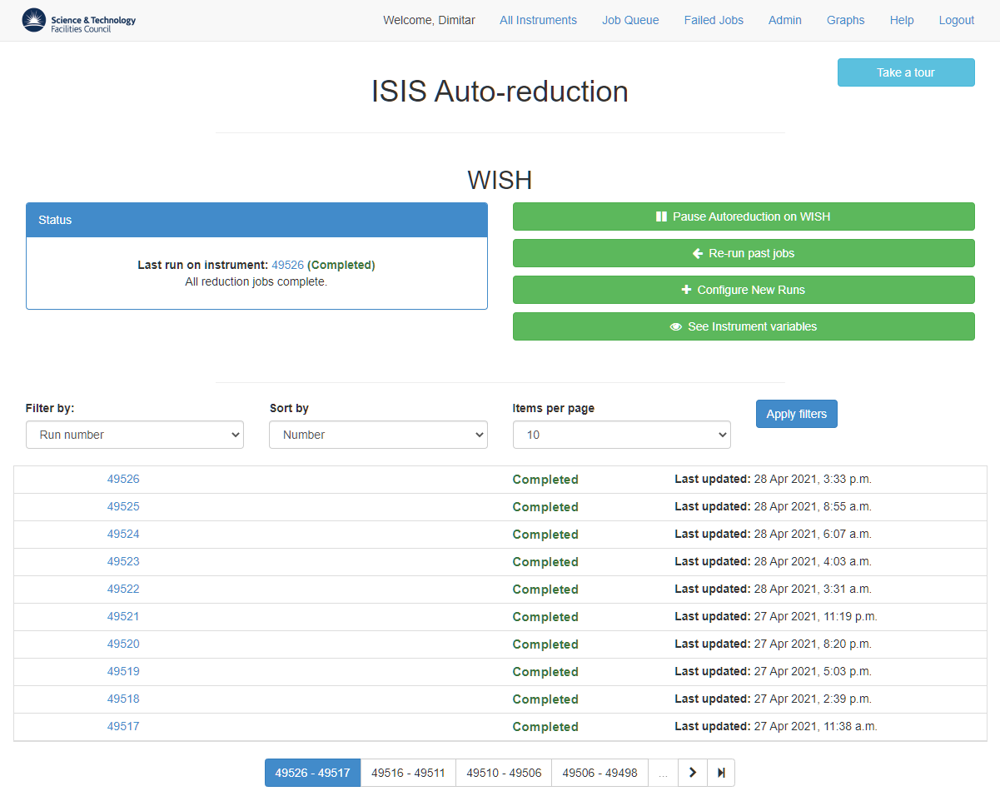

Slide 22
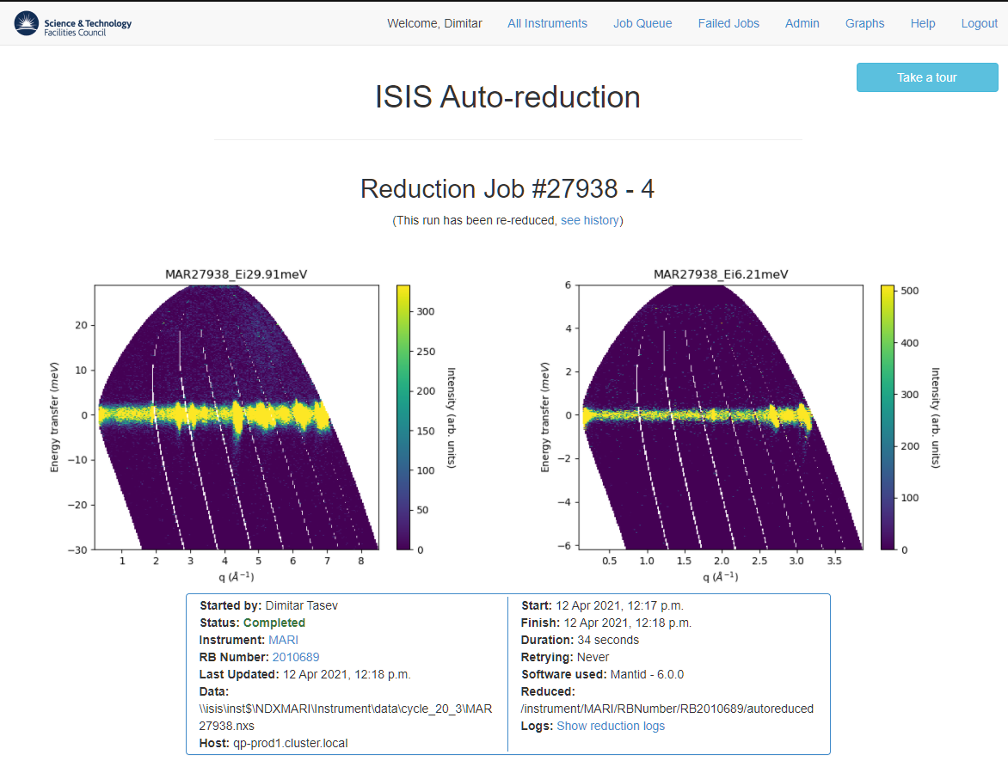

Slide 23
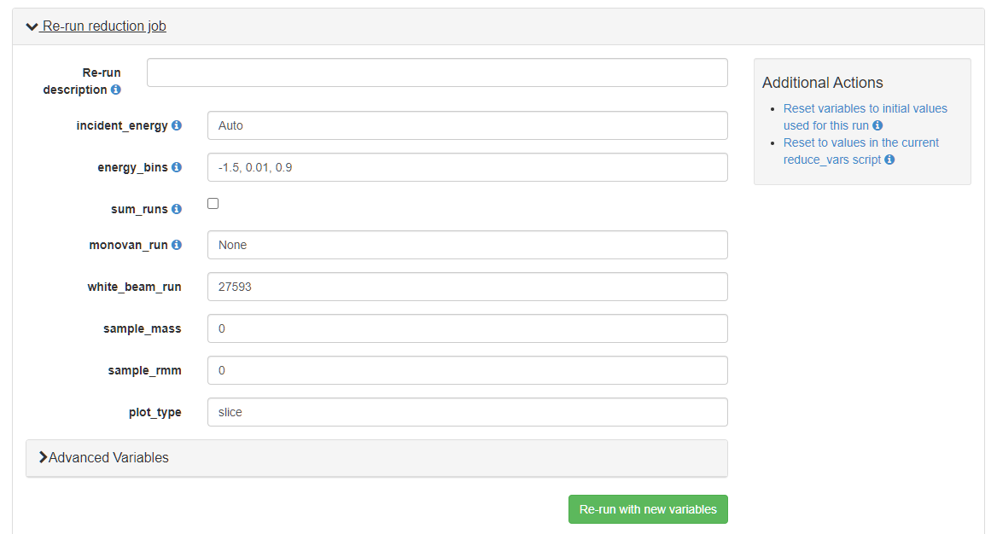

Slide 24
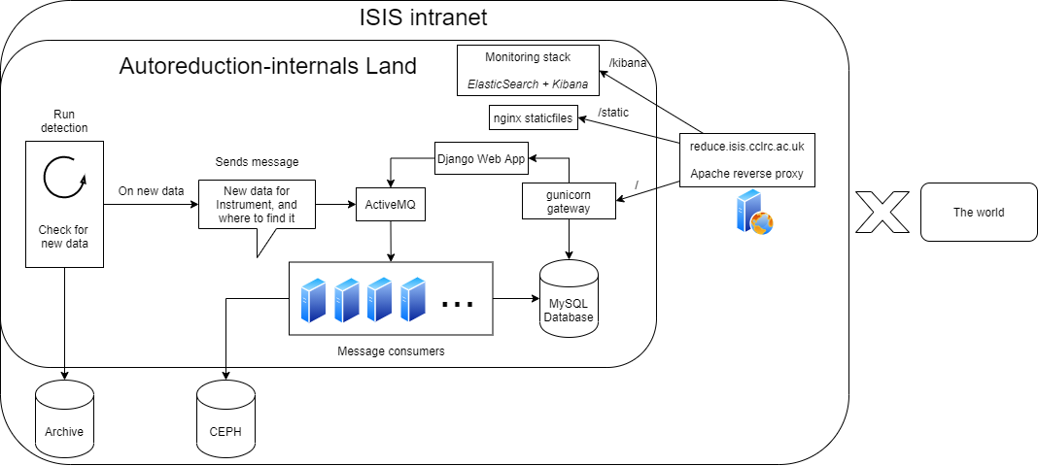

Slide 25
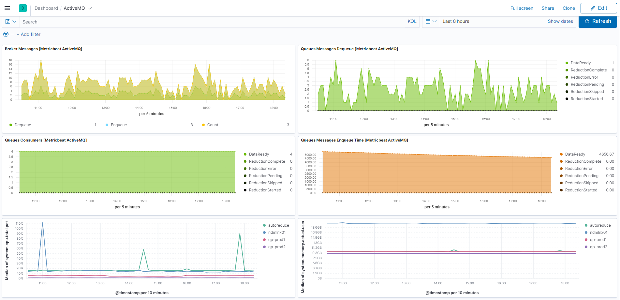
Ansible
Containers
Singularity (Docker)
ElasticSearch + Kibana

Slide 26
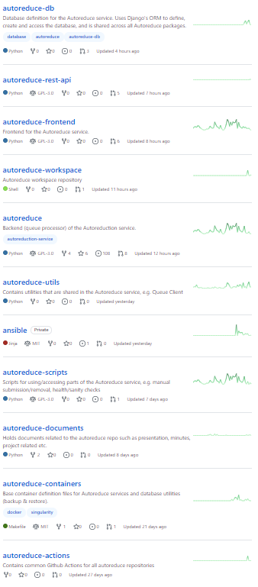
ISISScientificComputing/autoreduce: Backend (queue processor) of the Autoreduction service. (github.com)
Dimitar Tasev: dimitar.tasev@stfc.ac.uk

Slide 27
Agenda
Intro
Manual Data Analysis/Reduction
Automatic Data Reduction
Future Demands & Developments
Image © STFC Alan Ford

Slide 28
What is missing? IDAaaS
New web front end (SciGateway plugin)
Customise software installed on VM
Authentication through ISIS UO interface
Interface to HPC clusters, e.g. SCARF
Ability to use external clouds (IRIS….)
Make available on EOSC

Slide 29
What is missing? Autoreduction
Remaining rollout and cater for remaining individual science needs
Upgrade ActiveMQ/database with Kafka
Enrich ISIS data catalogue (expand script API / capture run environment)
Continuing consider (cloud) deployment option
Also allow reduction scripts in the format of Jupyter notebooks
Possibly web front upgrade
Extend to automation of data analysis workflow (future)

Slide 30





Slide 31






Science and Technology Facilities Council
@STFC_Matters
Science and Technology Facilities Council

